Slide 1
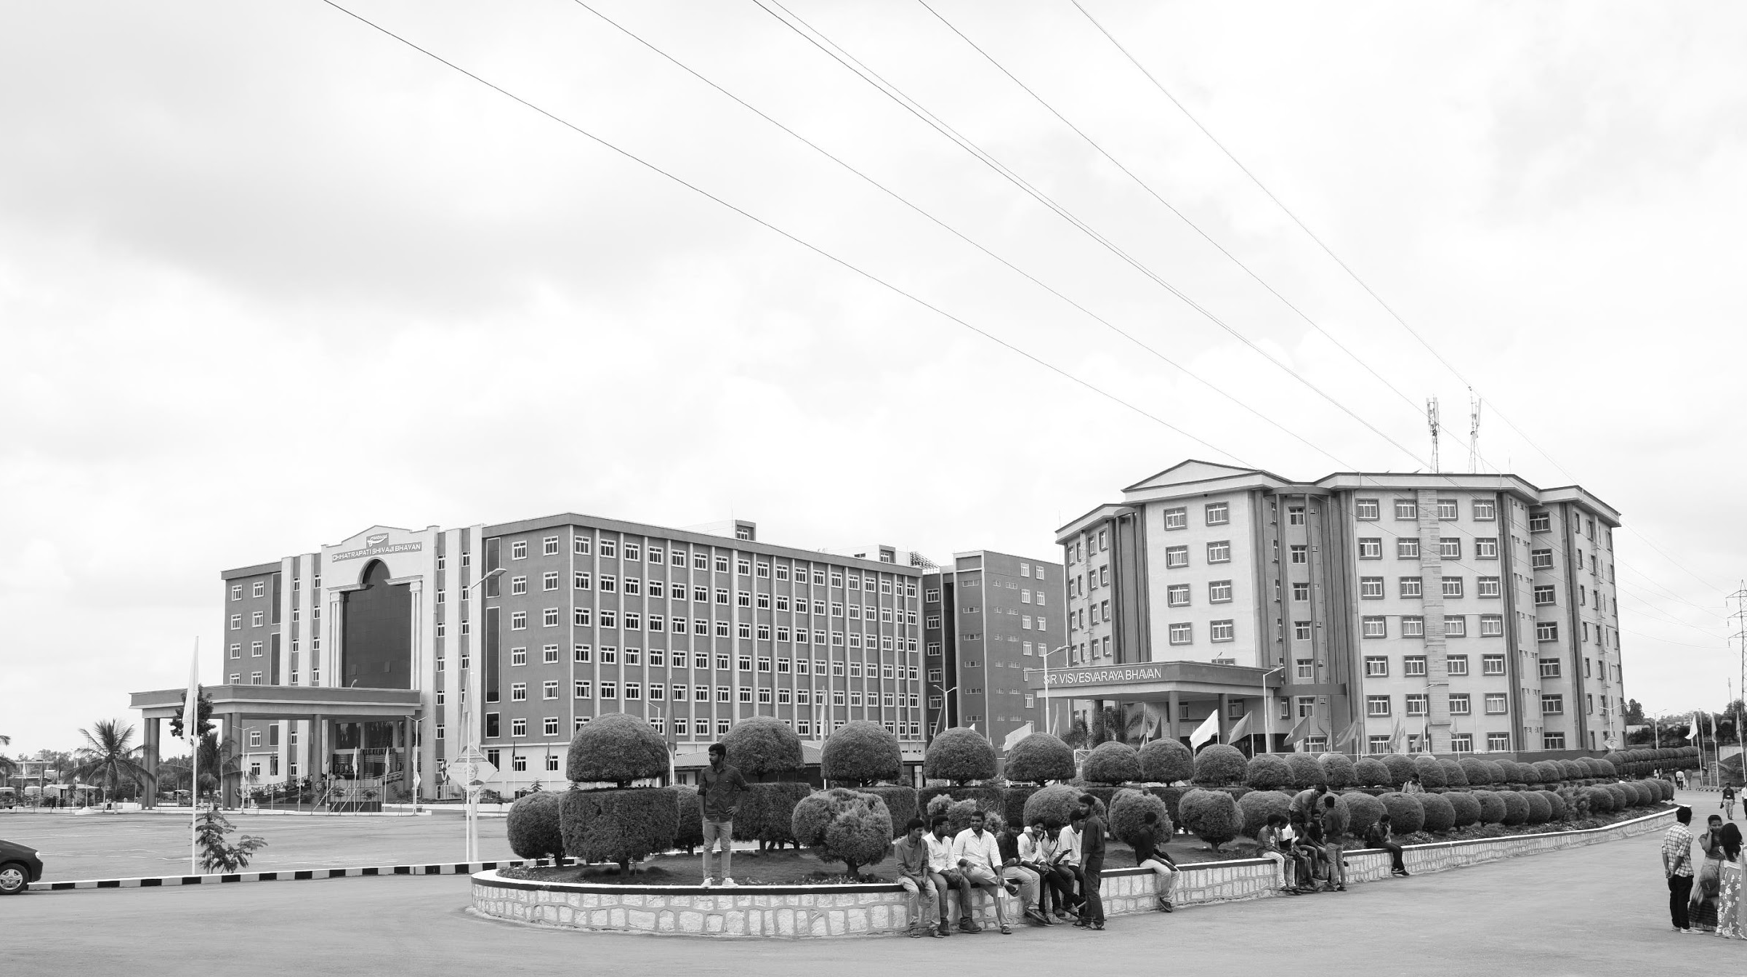

Review-I
VEHICLE CONTROL UNIT
AY 2025-26
Capstone Project – Introduction (PROJ2999)
GITAM (Deemed-to-be) University
Department of Electrical Electronics and Communication Engineering
Project Team:
CHANDU C BU22EECE0100480
BHARATH J BU22EECE0100479
MANOHAR R BU22EECE0100302
Project Mentor:
Dr. Pradyumna Ranjan Ghosh
Project In-charge:
Dr. Subhashish Tiwari
www.gitam.edu

Slide 2
Objective and Goals
Objective
To create a standardized Vehicle Control Unit VCU design architecture corresponding to AUTOSAR standards for two-wheeler electric vehicles.
To carry out CAN protocol integration for dependable subsystem communication with BMS, MCU, and User Interface.
To evaluate systems for constituent structure based on modular design, and the refactorability to be gained through layered architecture.
To evaluate the resource usage and reliability to the communication under constraints for two-wheeler EVs.
To provide a VCU solution that is inexpensive and is easy to maintain for use in academic studies and industry.
Goals
Main Goals
Establish the base framework of the Vehicle Control unit of two-wheeler Electric Vehicles (EV) and implement the control unit using the guidelines of the AUTOSAR standard.
Execute the implementation of the CAN protocol for inter subsystem (BMS, motor control, user interface) secure communication.
The system must be strong, economical and easy to service for real world implementation.
The software should be designed in such a way that allows for integration of future modular features of the EV.
Additional Goals
Reference model for academic research on automotive embedded systems.
Facilitate communication reliability and resource usage validation simulation and testing.
Simplify the addition of new modules like telematics and IoT based monitoring.
Advocate for the application of AUTOSAR standards for two-wheeler electric vehicles.

Slide 3
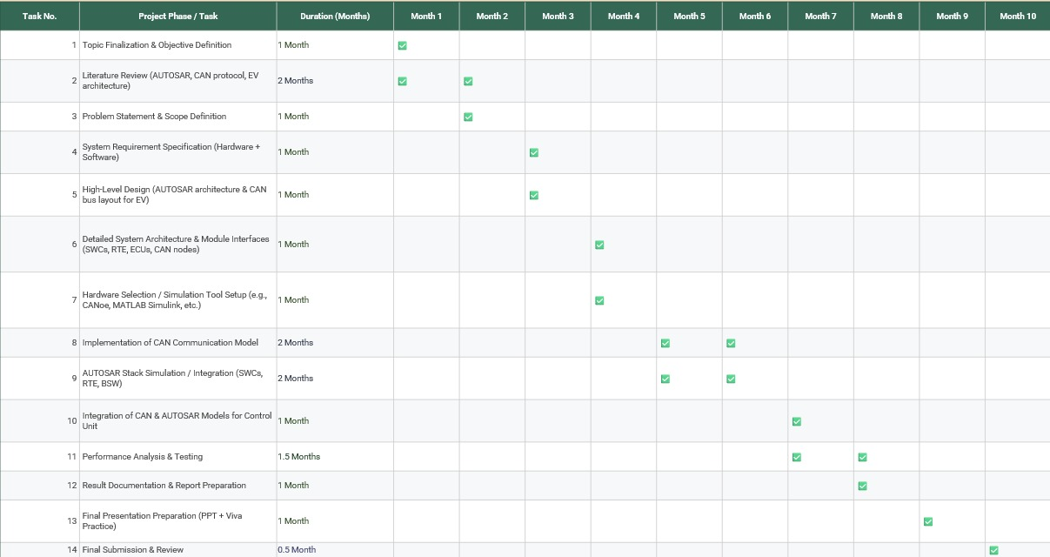
Project Plan

Slide 4
Literature Survey
Studies show AUTOSAR provides modular, layered architecture that increases software portability and reusability.
Researchers highlight that AUTOSAR improves integration of different subsystems like BMS, motor control, and user interface.
CAN protocol is widely reported as a reliable and low-cost communication bus in automotive systems.
Literature emphasizes CAN’s error detection, priority-based messaging, and suitability for resource-limited EV platforms.
Prior works on VCU architectures show their role as the “brain” of EVs, ensuring safe power management and torque control.
Two-wheeler EVs demand lightweight, cost-effective VCUs due to tighter space and cost limits compared to four-wheelers.
Research also shows that AUTOSAR can be adapted for smaller ECUs with limited processing capacity.
Battery management integration with VCUs is well-studied for ensuring safe charging, discharging, and thermal protection.
Motor controller communication with the VCU enables smooth torque delivery and regenerative braking.
Previous research confirms that modular VCUs improve maintainability and long-term scalability of EV systems.
Overall, existing studies support the idea that combining AUTOSAR and CAN leads to robust, standardized, and future-ready VCU designs.

Slide 5
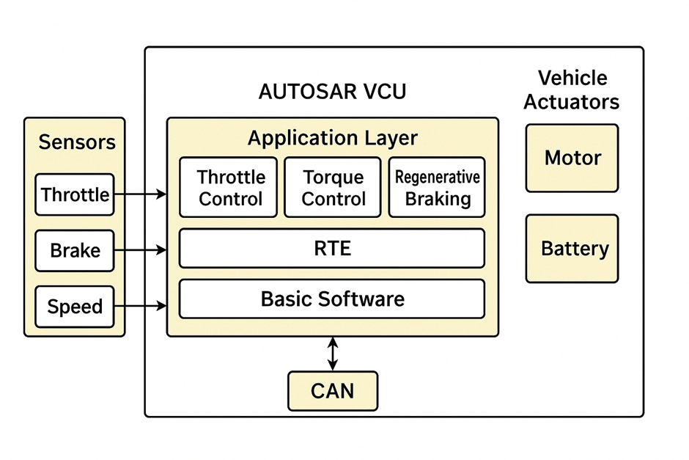
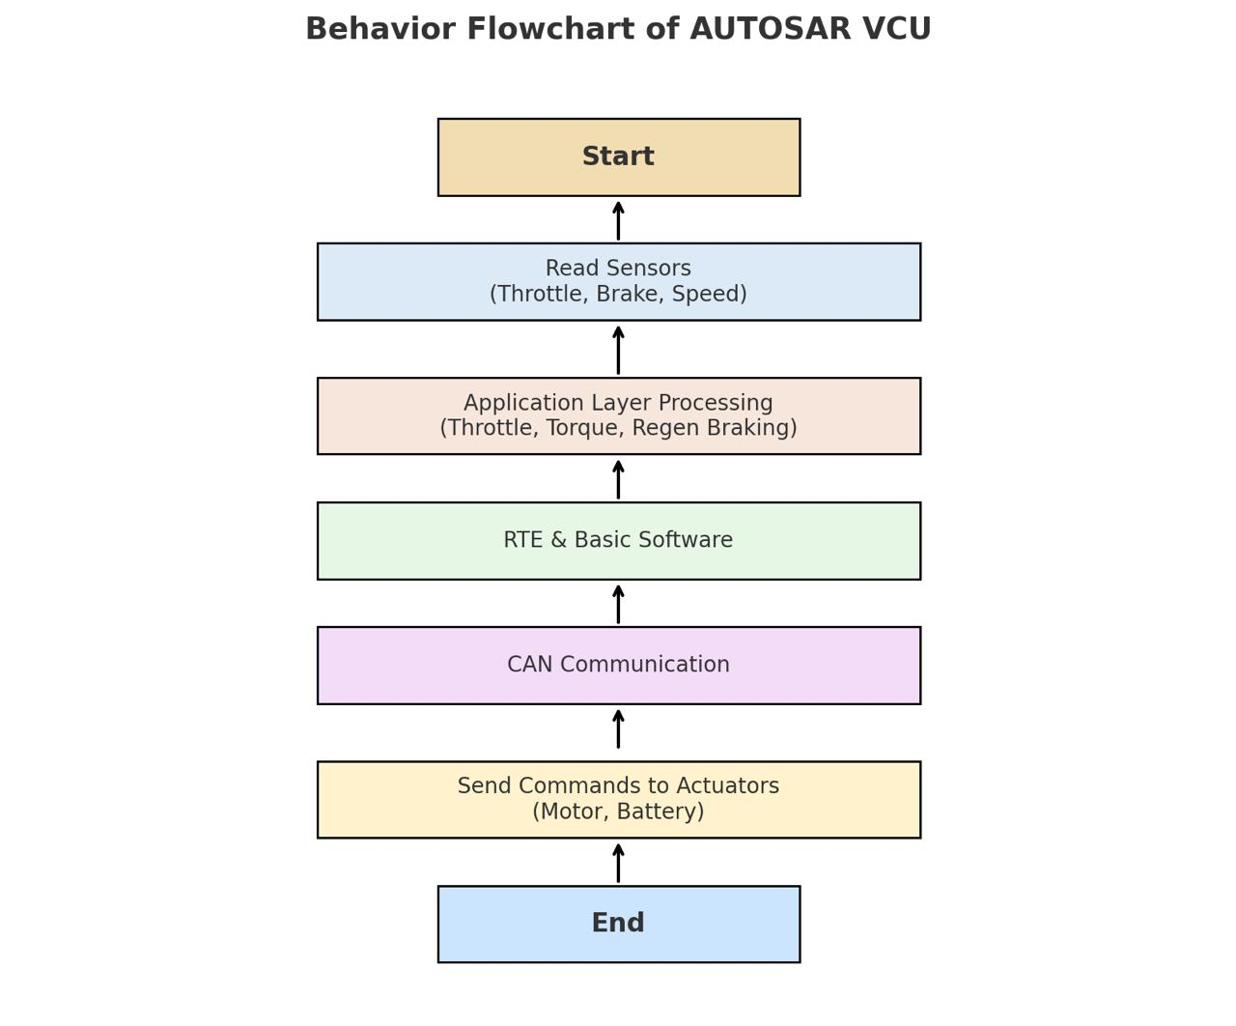
Architecture
Structural Diagram
Block Diagram/Pin Diagram
Behaviour Diagram
Flow chart/ State machine

Slide 6
Battery Management Integration
Use Case: Monitor State of Charge (SOC), State of Health (SOH).
Actor: VCU ↔ Battery Management System (BMS).
Goal: Prevent overcharge/discharge, optimize battery life.
Motor Control & Torque Request
Use Case: Interpret throttle input and send torque demand to Motor Controller.
Actor: Rider ↔ VCU ↔ Motor Control Unit.
Goal: Ensure smooth acceleration and regenerative braking.
Vehicle Diagnostics & Fault Handling
Use Case: Detect abnormal temperature, voltage, current, or communication errors.
Actor: VCU ↔ Sensors ↔ User Interface (cluster).
Goal: Trigger error messages, enter safe mode, log faults.
User Interface Communication
Use Case: Display speed, battery level, and warnings on dashboard.
Actor: VCU ↔ Instrument Cluster.
Goal: Provide real-time feedback to rider.
Scalability for Future Features
Use Case: Support add-ons like IoT tracking, GPS, or remote diagnostics.
Actor: VCU ↔ External Modules via CAN.
Goal: Enable future upgrades without redesign.
Use Cases & Testing
Use Cases
Test Cases
1. Unit Testing
Test each software module (BMS interface, motor control, CAN stack).
Verify input-output mapping at code level.
2. Integration Testing
Check communication between BMS, Motor Controller, and User Interface via CAN.
Ensure message IDs and data frames are transmitted correctly.
3. System Testing
Simulate real driving conditions (acceleration, braking, battery drain).
Validate that torque control, fault handling, and UI feedback work as intended.
4. Fault Injection Testing
Inject errors (e.g., CAN bus off, wrong sensor data, overheating).
Observe if VCU enters safe/limp mode.
5. Performance Testing
Measure CPU load, memory usage, and CAN bus utilization.
Ensure system meets real-time constraints of two-wheeler EV.
6. Hardware-in-the-Loop (HIL) Testing (if possible)
Connect VCU to a simulation environment.
Run driving cycles (start, stop, uphill, downhill) virtually to test logic.

Slide 7
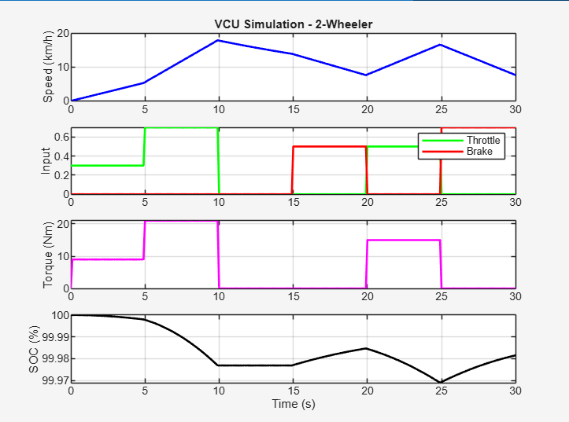
Implementation and Results

Slide 8
Speed (km/h):
The blue line shows the vehicle's speed, starting at 0 km/h and rising to a peak of around 18 km/h by 5 seconds, followed by fluctuations between 10-15 km/h until 25 seconds, with a final increase to about 20 km/h.
This reflects the VCU's response to throttle and brake inputs, simulating acceleration, cruising, and minor speed adjustments.
Input Signals (Throttle and Brake):
The green line (throttle) and red line (brake) represent normalized input values (0 to 0.6).
Throttle is active in pulses (e.g., 0.4-0.6) around 0-10 seconds, 15-20 seconds, and 25-30 seconds, indicating driver acceleration commands.
Brake is active in corresponding pulses (e.g., 0.4-0.6) around 10-15 seconds and 20-25 seconds, showing deceleration phases.
The VCU interprets these inputs to control motor power and braking.
Torque (Nm):
The magenta line depicts torque, peaking at 20 Nm during throttle phases (0-5 seconds, 15-20 seconds, 25-30 seconds) and dropping to 0 Nm during brake phases (10-15 seconds, 20-25 seconds).
This indicates the VCU's torque management, aligning with throttle for acceleration and reducing torque during braking.
State of Charge (SoC, %):
The black line shows SoC, starting near 99.99% and gradually declining to about 99.97% by 30 seconds.
The slow decrease reflects minimal energy consumption over the short simulation, consistent with a 2-wheeler's efficient operation under the VCU's control.
DISCUSSION

Slide 9
Conclusion & Future Work
Summary and Conclusion
The capstone project on the "Vehicle Control Unit (VCU) for a 2-Wheeler Electric Vehicle" designs a robust, efficient, and safe control system to enhance urban mobility and reduce environmental impact, drawing from Littelfuse’s circuit protection and sensing techniques. It explores an AUTOSAR-compliant VCU architecture with CAN bus integration, focusing on optimizing battery range, ensuring reliability with components like TVS diodes and MOSFETs, and meeting standards such as ISO 8820 and AEC-Q. The project successfully establishes a scalable foundation for eco-friendly 2-wheeler EVs, addressing key challenges of power efficiency and fault tolerance. Leveraging industry-standard components and modular software, it offers a practical solution for sustainable transportation. Future efforts could include hardware prototyping and real-world testing to validate performance across diverse conditions.
Future Work
The project can be extended by developing a hardware prototype using Arduino or STM32 to validate the VCU design in real-world conditions. Integration of advanced features like regenerative braking and machine learning-based energy optimization could further enhance efficiency. Field testing across varied terrains and weather conditions will ensure robustness and compliance with international safety standards. Collaboration with industry partners could facilitate scaling the design for commercial 2-wheeler EV applications.

Slide 10
THANK YOU
Have a Great Day !

